Slide 1
Systems Analysis
and Design
Lecture 4
Identifying and Selecting Systems Development Projects

Slide 2
Learning Objectives
Describe the project identification and selection process.
Describe corporate strategic planning and information systems planning process.
Explain the relationship between corporate strategic planning and information systems planning.

Slide 3
Learning Objectives (Cont.)
Describe how information systems planning can be used to assist in identifying and selecting systems development projects.
Analyze information systems planning matrices to determine affinity between information systems and IS projects and to forecast the impact of IS projects on business objectives.

Slide 4
The Process of Identifying and Selecting IS Development Projects
Identifying potential development projects
  Identification from a stakeholder group.
    Each stakeholder group brings their own perspective and motivation to the IS decision.

Slide 5
The Process of Identifying and Selecting IS Development Projects
  Top-down source are projects identified by top management or by a diverse steering committee.
  Bottom-up source are project initiatives stemming from managers, business units, or the development group.
  The process varies substantially across organizations.

Slide 6
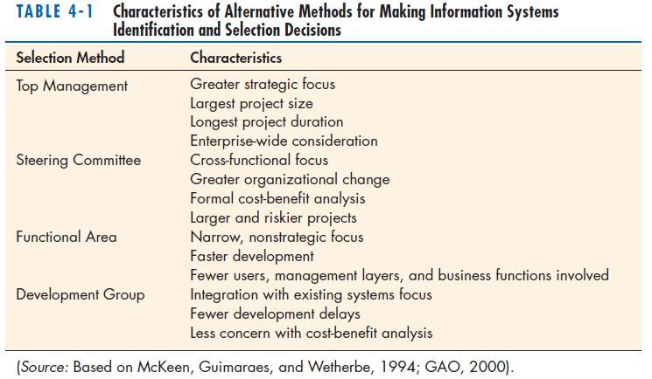
The Process of Identifying and Selecting IS Development Projects (Cont.)

Slide 7
The Process of Identifying and Selecting IS Development Projects (Cont.)
Classifying and ranking IS development projects
  Using value chain analysis or other evaluation criteria
  Value chain analysis: the process of analyzing an organization’s activities for making products and/or services to determine where value is added and costs are incurred

Slide 8
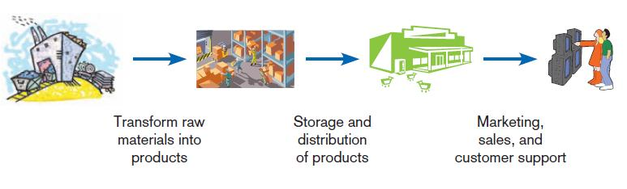
The Process of Identifying and Selecting IS Development Projects (Cont.)
FIGURE 4-2
Organizations can be thought of as a
value chain, transforming raw materials
into products for customers.

Slide 9
The Process of Identifying and Selecting IS Development Projects (Cont.)
Selecting IS development projects
  Based on various factors
  Both short- and long-term projects considered
  Most likely to achieve business objectives selected
  Is a very important and ongoing activity

Slide 10
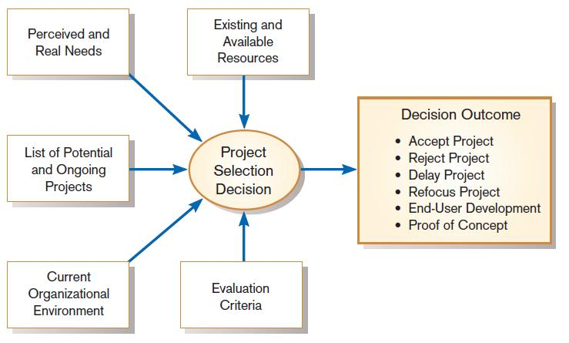
The Process of Identifying and Selecting IS Development Projects (Cont.)
FIGURE 4-3
Project selection decisions must consider numerous factors and can have numerous outcomes.

Slide 11
The Process of Identifying and Selecting IS Development Projects (Cont.)
One method for deciding among different projects or alternative designs is:
  For each requirement or constraint:
  Score = weight X rating
  Each alternative: sum scores across requirements/constraints.
  Alternative with highest score wins.

Slide 12
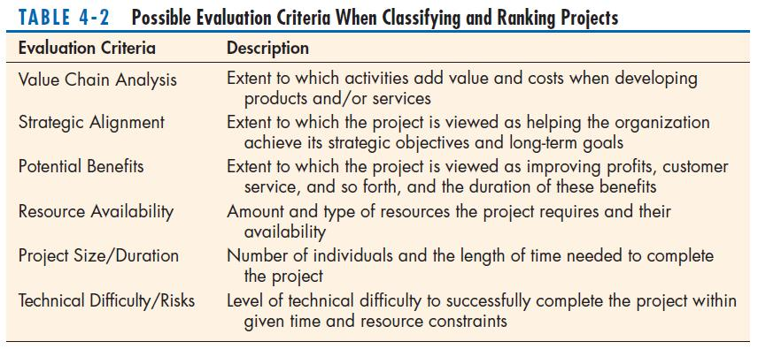
The Process of Identifying and Selecting IS Development Projects (Cont.)

Slide 13
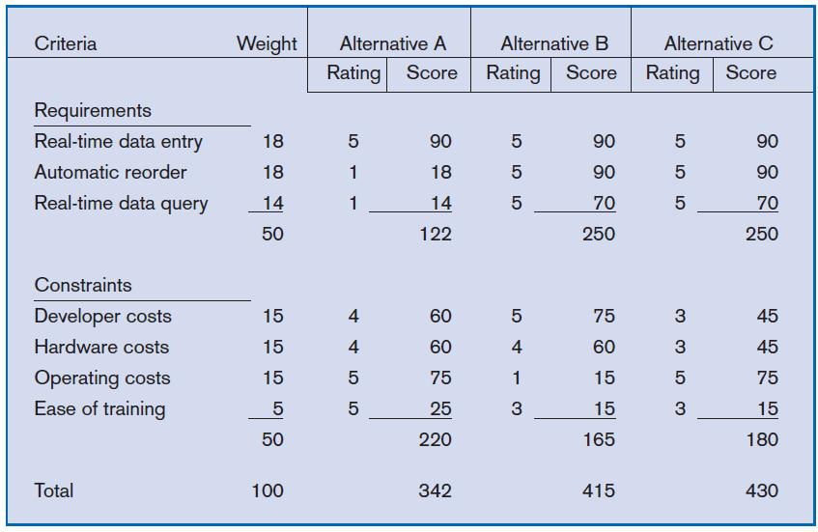
The Process of Identifying and Selecting IS Development Projects (Cont.)
FIGURE 4-4
Alternative projects and system design
decisions can be assisted using weighted
multicriteria analysis.

Slide 14
Deliverables and Outcomes
Primary deliverable from the first part of the planning phase is a schedule of specific IS development projects.
Outcome of the next part of the planning phase – project initiation and planning – is the assurance that careful consideration was given to project selection and each project can help the organization reach its goals.

Slide 15
Deliverables and Outcomes
Incremental commitment: a strategy in systems analysis and design in which the project is reviewed after each phase and continuation of the project is rejustified.

Slide 16
Corporate and Information Systems Planning
To benefit from a planning-based approach for identifying and selecting projects, an organization must :
  Analyze its information needs thoroughly.
  Plan its projects carefully.

Slide 17
Corporate Strategic Planning
Ongoing process that defines mission, objectives, and strategies of an organization

Slide 18
Corporate Strategic Planning
Corporate strategy involves:
  Mission statement
  Objective statements
  Description of competitive strategy

Slide 19
Corporate Strategic Planning (Cont.)
Mission statement: A statement that makes it clear what business a company is in.

Slide 20
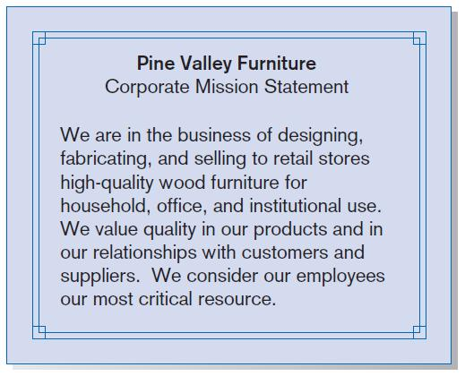
Corporate Strategic Planning (Cont.)
FIGURE 4-7
Mission statement (Pine Valley Furniture)

Slide 21
Corporate Strategic Planning (Cont.)
Objective statement: a series of statements that express an organization’s qualitative and quantitative goals for reaching a desired future position

Slide 22
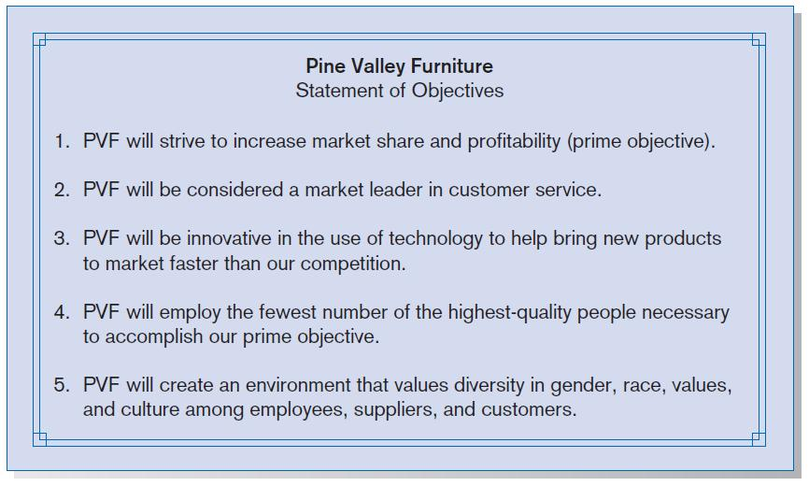
Corporate Strategic Planning (Cont.)
FIGURE 4-8
Statement of Corporate Objectives
(Pine Valley Furniture)

Slide 23
Corporate Strategic Planning (Cont.)
Competitive strategy: the method by which an organization attempts to achieve its mission and objectives
Main types:
  Low-cost producer
  Product differentiation
  Product focus or niche

Slide 24
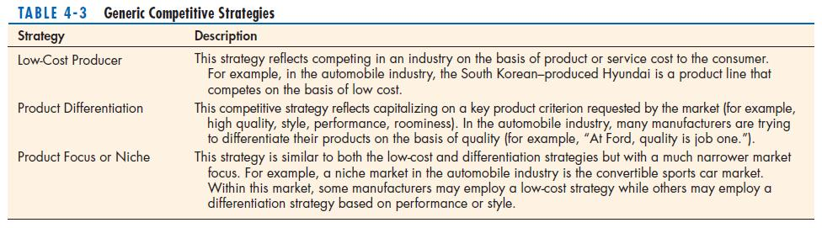
Corporate Strategic Planning (Cont.)

Slide 25
Information Systems Planning (ISP)
An orderly means of assessing the information needs of an organization and defining systems, databases, and technologies that will best meet those needs
ISP must be done in accordance with the organization's mission, objectives, and competitive strategy.

Slide 26
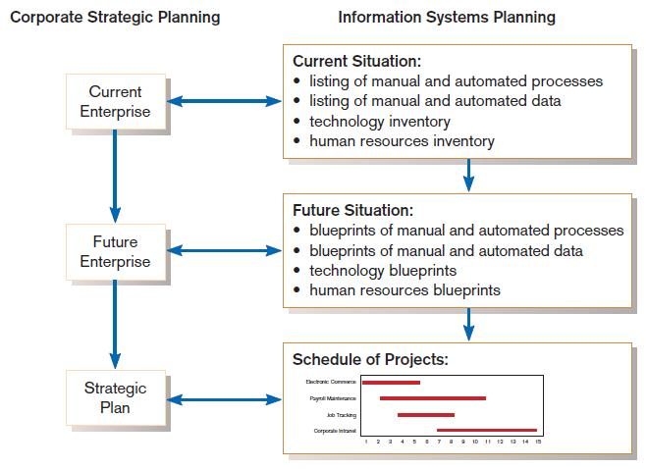
Information Systems Planning (Cont.)
FIGURE 4-10
Parallel activities of corporate strategic planning and information systems planning

Slide 27
Information Systems Planning (Cont.)
IS planning must be kept in line with corporate strategic planning.

Slide 28
Information Systems Planning (Cont.)
Top-down planning attempts to gain a broad understanding of information system needs of the entire organization and offers:
  Broader perspective.
  Improved integration.
  Improved management support.
  Better understanding.

Slide 29
Information Systems Planning (Cont.)
Bottom-up planning identifies IS development projects based on solving specific operational business problems or taking advantage of specific opportunities.
  Can be faster and less costly, so may be beneficial in certain circumstances.

Slide 30
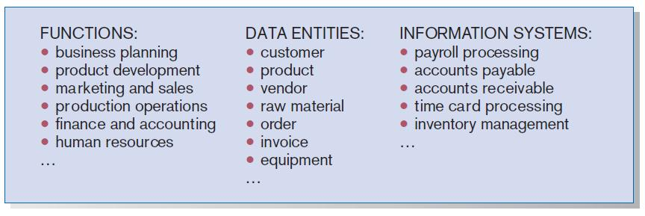
Business Functions, Data Entities, and Information Systems of PVF
FIGURE 4-11
Information systems planning information
(Pine Valley Furniture)

Slide 31
Information Systems Planning of Pine Valley Furniture (PVF)
Functional Decomposition: breaking high-level abstract information into smaller units for more detailed planning

Slide 32
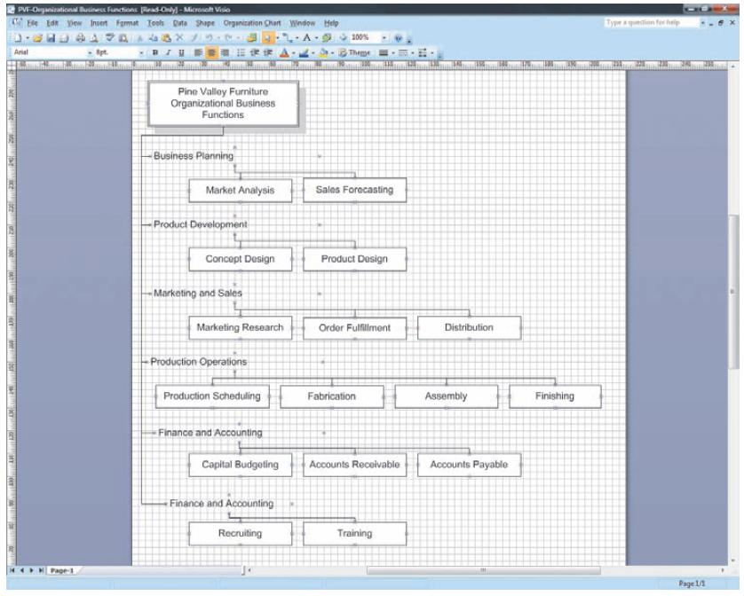
FIGURE 4-12
Functional decomposition of information systems planning information (Pine Valley Furniture)

Slide 33
IS Plan Components
Briefly describe mission, objectives, and strategy of the organization.
Provide summary of current and future processes, functions, data entities, and information needs of the enterprise.

Slide 34
IS Plan Components (Cont.)
Describe primary role IS will play in the organization to transform enterprise from current to future state.
Describe limitations imposed by technology and current levels of financial, technical, and personnel resources.

Slide 35
IS Plan Components (Cont.)
Summarize overall information systems needs in the company and set long-term strategies for filling the needs.
Show detailed inventory of present projects and systems and detailed plan for the current year.

Slide 36
IS Plan Components (Cont.)
Describe unknown but likely events that can affect the plan, presently known business change elements and their impact on the plan.

Slide 37
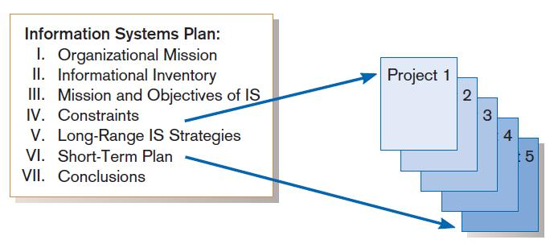
Information Systems (IS) Plan
FIGURE 4-16
Systems development projects flow from the information systems plan

Slide 38
Summary
In this chapter you learned how to:
  Describe the project identification and selection process.
  Describe corporate strategic planning and information systems planning.
  Explain the relationship between corporate strategic planning and IS planning.

Slide 39
Summary (Cont.)
  Describe how IS planning can assist in system development project identification and selection.

